Slide 1
A brief introduction of spintronics
CRR
1701110127

Slide 2
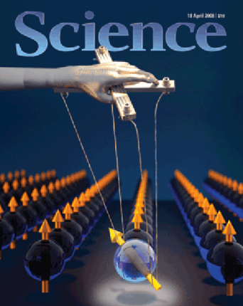
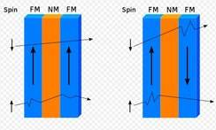
What is the spintronics？
2007 Nobel Prize of Physics——GMR
Spintronics originated from giant magnetoresistance effect
Spintronics is a multidisciplinary filed whose central theme is the active manipulation of spin degree of freedom, to find some novel physics phenomenons.
Traditional electronics is to manipulate charge freedom
Spin is the basic physical parameter of electrons.
Spin has two orientations in any direction (spin-up and spin down), which is the result of quantum mechanics.

Slide 3
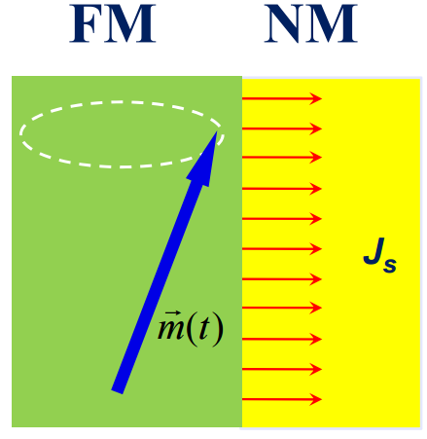
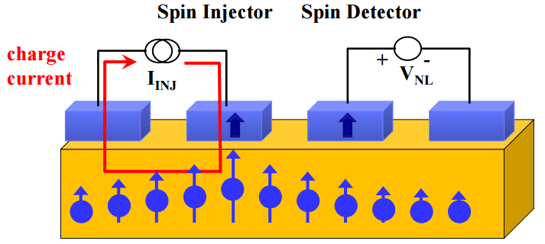
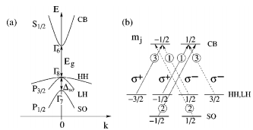
Conventional method to generate spin current
Electrical method
Optical method
Dynamical method
Generating spin current is an important step in spintronics

Slide 4
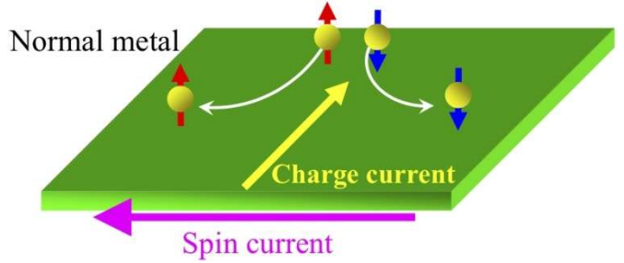
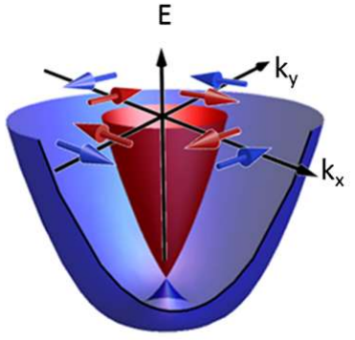
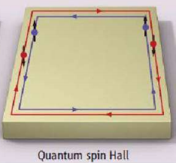
Spin current in some special materials
Spin Hall Effect in heavy metal
Rashba Effect in 2DEG
Spin-Oribt coupling
Spin-Momentum locking in TI

Slide 5
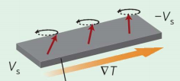
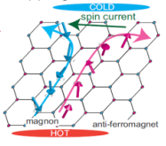
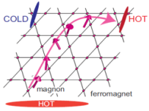
Spin wave in magenatical materials
Spin current also can exit in magenatical insulators without itinerant electron in the form of spin wave
Spin Seebeck Effect
Spin Nernst Effect
Thermal activation
spin thermal activation is a powerful method for identification of new quantum magnetic materials
Thermal Hall Effect

Slide 6
To be continued

